Slide 1

Object Oriented Programming
Templates
Lecture 16
By: Ahmad Arsalan

Slide 2
Templates in C++ is an interesting feature that is used for generic programming.
Generic Programming is an approach of programming where generic types are used as parameters in algorithms to work for a variety of data types.
Templates in C++ is defined as a blueprint or formula for creating a generic class or a function.
To simply put, you can create a single function or single class to work with different data types using templates.
Templates

Slide 3
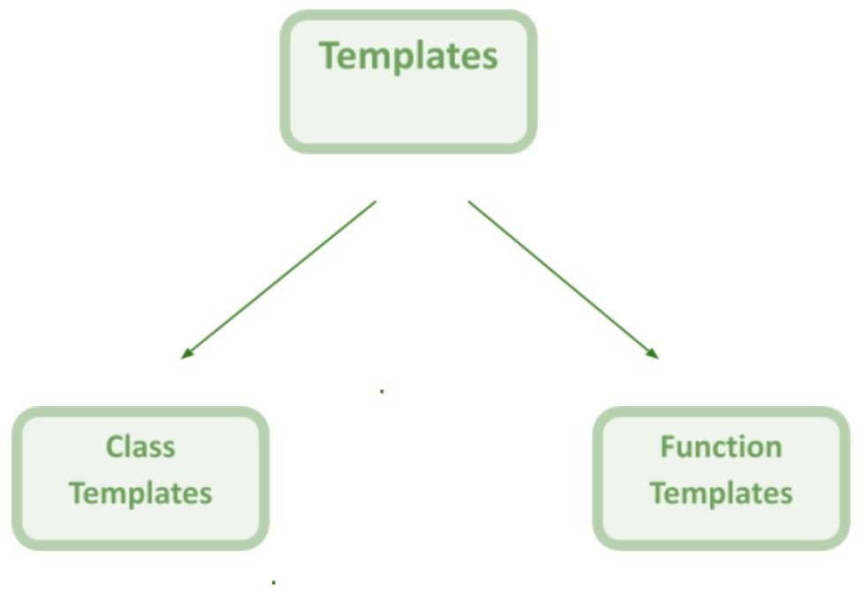

Slide 4
Function template in C++ is a single function template that works with multiple data types simultaneously, but a standard function works only with one set of data types.
Syntax:
//typename/class are the keywords you can use anyone of them at a time.
template <typename/class T>
T functionName(T parameter1, T parameter2, ...)
{ // code }
Function
Templates

Slide 5





nclude< ostream> us ng name space std;
Tem p late<class T> T add(T a, T b)
{
return a + b;
}
nt ma n()
{
nt ans = add< nt>(20, 12);
double ans2 = add<double>(12.3, 34.3); cout << "Integer Add t on: " << ans;
cout << endl << "Double Add t on: " << ans2;
}

Slide 6
nclude< ostream>
us ng namespace std;
template<class T1,class T2>
nt add(T1 a, T2 b)
{
return a + b;
}
nt ma n()
{
nt ans = add< nt, nt>(20, 12);
double ans2 = add<double, nt>(12.3, 34.3);
cout << "Integer Add t on: " << ans;
cout << endl << "Double Add t on: " << ans2;
}

Slide 7
nclude< ostream> us ng namespace std;
template<class T>
vo d func(T &a)
{
a = 30.4;
cout << a;
}
nt ma n()
{
double x = 20.5; func< nt>(x); cout << " " << x;
}

Slide 8
nclude< ostream> us ng namespace std;
template<class T> vo d func(T *a)
{
cout << *a;
}
nt ma n()
{
nt x = 20; func< nt>(&x); cout << " " << x;
}

Slide 9

Write a template function that returns the average of all the elements of an array. The arguments to the function should be the array name and the size of the array (type int). In main(), exercise the function with arrays of type int, long, double, and char.
Create a function called swaps() that interchanges the values of the two arguments sent to it. (You will probably want to pass these arguments by reference.) Make the function into a template, so it can be used with all numerical data types (char, int, float, and so on). Write a main() program to exercise the function with several types.
Class Activities

Slide 10
The class template in c++ is like function templates. They are known as generic templates. They define a family of classes in C++.
Class Templates
Syntax:
template<class Ttype>
class class_name
{
//class body;
}

Slide 11
nclude< ostream> us ng namespace std; template<class T>
class Numbers
{
T num;
publ c:
Num b ers(T a):num(a){} vo d d splay()
{
cout << "Value: " << num;
}
};
nt ma n()
{
Numbers< nt> n1(20);
n1.d splay();
}

Slide 12
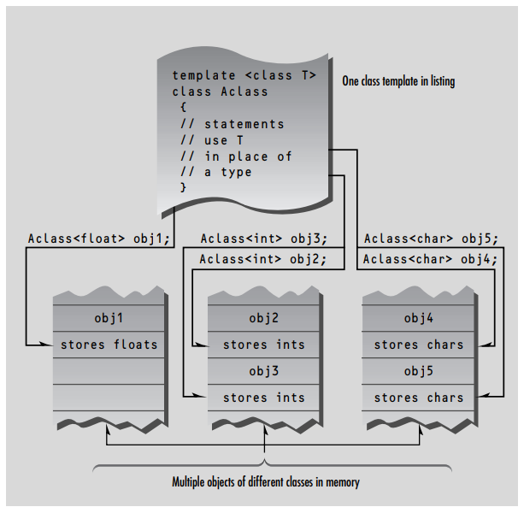

Slide 13
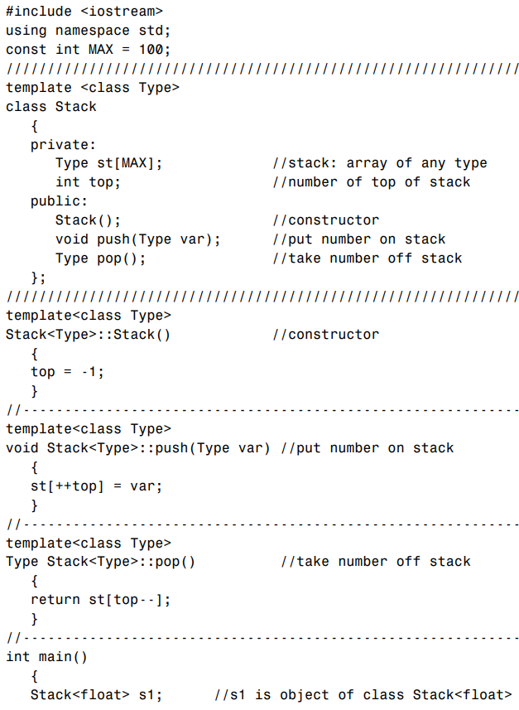
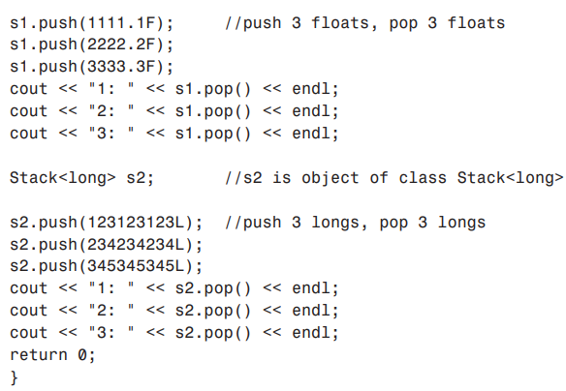
Class Name Depends on Context
If the member functions are defined externally (outside of the class specification), we need a new syntax.

Slide 14
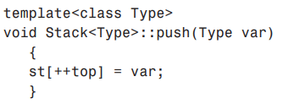
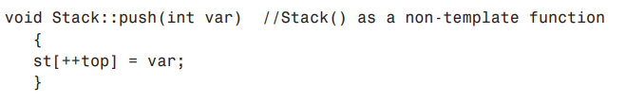
Class Name Depends on Context
The expression template<class Type> must precede not only the class definition, but each externally defined member function as well. Here’s how the push() function looks:
The name Stack<Type> is used to identify the class of which push() is a member.
In a normal non-template member function the name Stack alone would suffice:
but for a function template we need the template argument as well: Stack<Type>.

Slide 15
Class Template Inheritance in C++
#include <iostream>
using namespace std;
template<class T>
class Base
{
private:
T val;
public:
void setVal(T a) { val = a; }
};
template<class T>
class Derived : public Base<T>
{
public:
void setVal (T b) { Base<T>::setVal(b); }
};
int main()
{
Derived<int> a;
a.setVal(4);
return 0;
}
Inheriting from a template class is feasible. All regular inheritance and polymorphism rules apply.
Syntax:
template <class T>
class derived : public Base<T>{};

Slide 16
Class Template Inheritance in C++
The derived class can have its template parameters as well. The previous example can be modified as follows:
template<class T , class S>
class Derived : public Base<T>
{
private:
S data;
public:
void setVal (T b)
{
Base<T>::setVal(b);
data = b;
}
};

Slide 17
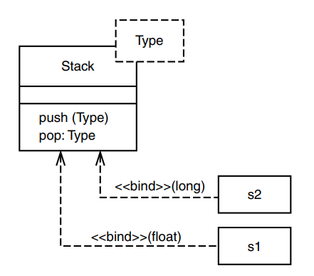
The UML and Templates
Templates (also called parameterized classes in the UML) are represented in class diagrams by a variation on the UML class symbol.
The names of the template arguments are placed in a dotted rectangle that intrudes into the upper right corner of the class rectangle.

Slide 18
Class Activity
Create a function called amax() that returns the value of the largest element in an array. The arguments to the function should be the address of the array and its size. Make this function into a template so it will work with an array of any numerical type. Write a main() program that applies this function to arrays of various types.

Slide 19
Standard Template Library (STL)
The C++ STL (Standard Template Library) is a powerful set of C++ template classes to provide general-purpose classes and functions with templates that implement many popular and commonly used algorithms and data structures like vectors, lists, queues, and stacks.
Developed by Stepanov and Lee at HP labs in 1992
Become part of the C++ Standard in 1994
Why use STL?
Reuse
Time Saving

Slide 20
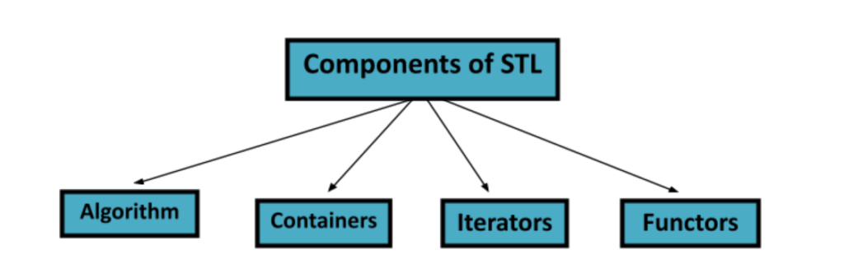
Components of STL

Slide 21
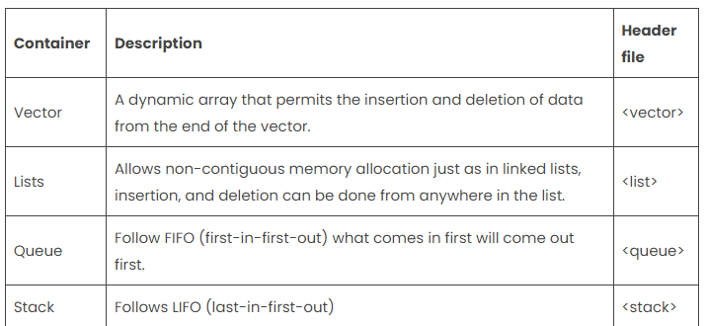
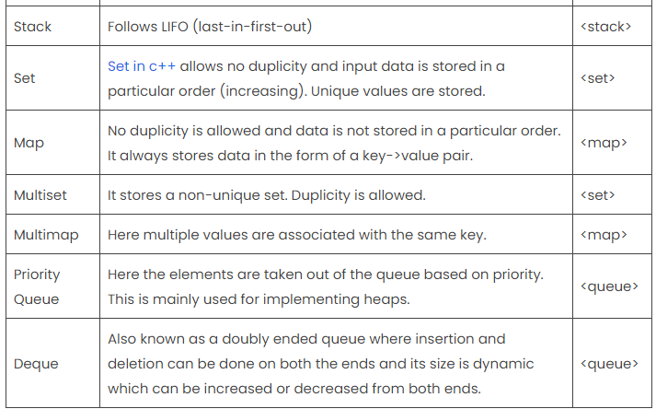
Containers
This helps the programmer to store the data in the listed below containers for further operations on the data.
It’s like people standing in the row; with the power in the hands of the executor to manipulate the row in his/her choice and can add more people in the row in any fashion.

Slide 22
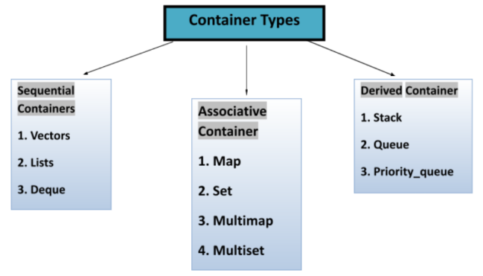

Slide 23
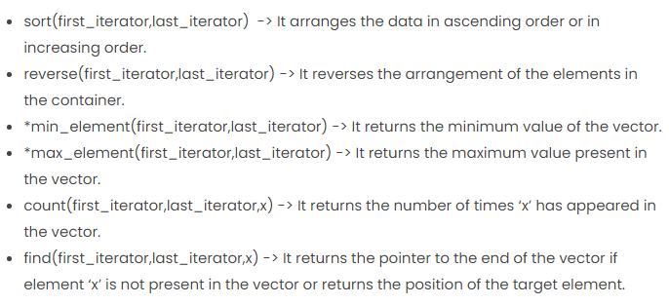
Algorithms
Algorithms act on container data with some predefined functions, wherein data gets changed for better results, and provide a smooth way for further manipulation.
Suppose there are some coins and one has to arrange them in increasing order of their values, so one applies the “strategy” to place the coins in a row and then swapping their positions to sort them in increasing order, so the “strategy” or technique one has used can be said as an algorithm which enables to sort the coins.

Slide 24
Iterators
Iterators are the “smart pointers” that point to the data in the container like pointers do, but help in traversing over complex data structures, which pointers cannot do efficiently.
It’s similar to blinking text cursor in editors, while typing they initially appear at the starting and as we type, it automatically shifts itself to the end of the content but can be taken anywhere in the text area.
Iterators move as instructed by algorithms.

Slide 25
Vector In C++ STL
Syntax
vector<data_type> vector_name;
#include<iostream>
#include<vector>
int main(){
vector<int> vec1;
return 0;
}

Slide 26
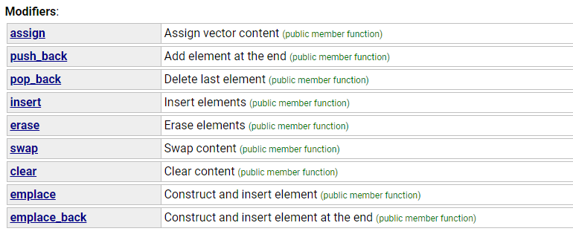
Vectors in C++
#include<iostream>
#include<vector>
using namespace std;
void display(vector<int> &v){
for (int i = 0; i < v.size(); i++)
{
cout<<v[i]<<" ";
}
cout<<endl;
}
int main(){
vector<int> vec1;
int element, size;
cout<<"Enter the size of your vector"<<endl;
cin>>size;
for (int i = 0; i < size; i++)
{
cout<<"Enter an element to add to this vector: ";
cin>>element;
vec1.push_back(element);
}
display(vec1);
return 0;
}

Slide 27
Vectors in C++
Iterators
Syntax
vector<int> :: iterator iter = vec1.begin();
Using begin () points the iterator to the starting of the vector.
display(vec1);
vector<int> :: iterator iter = vec1.begin();
vec1.insert(iter,566);
display(vec1);

